Slide 1

An Intro to SAS 9 Programming – Week 1
March 10 2024
10 AM EST
Vijay Govindarajan

Slide 2
The Approach
Learn basics of SAS
Quickly cover the most important topics to get you to programming even while you are learning additional content.
Data step
A few basic procs: print, freq, means/summary, sgplot
Proc sqls
------- You start programming regularly in SAS at this point --------
Continue learning
SAS macros
Additional merging techniques
Formats and informats
ODS
Stats procedures

Slide 3
The Approach
Bite size pieces.. A little bit at a time.
Practice as much as you can.. Only hands on can improve your understanding and expertise.
Will try to share during the week:
Video(s) on further topics to expedite learning. We will review this at the beginning of the next class.
Some practice questions based on what we have learnt in today’s class to further your learning.

Slide 4
Agenda – Week 1
SAS Basics
Building blocks in SAS – data step and the proc step
Tour of popular SAS UI’s and our first data and proc step.
Step into the SAS Data step
Data processing – compile and execution
SAS log
Getting data into SAS
Demo
Temporary and Permanent datasets
A Few Basic Procs
Next class.

Slide 5
Basics
SAS reads input data and stores it into a proprietary form referred to as a SAS dataset.
Sas datasets typically have a file extension of sas7bdat.
Data is organized as variables or columns and observations or rows.
In SAS 9, there are 2 data types, numeric and character.
Missing character data are represented as blanks and missing numeric data are represented as a period or a dot.
Number of variables and observations in your SAS dataset is limited by your computer’s capacity to handle and store them.
In addition to storing your data in the dataset, SAS also stores metadata about the dataset such as: name, date created, version of SAS it was created, info about the variables such as name, type, length, position, formats and informats.

Slide 6
Basics continued…
Naming rules for datasets and variables:
Names must be 32 characters or shorter.
Must start with a letter or and underscore.
Names can contain letter, numbers or underscore*
Not case sensitive
Notes:
* - you can use VALIDVARNAMES=ANY option and use special characters in variable names using the form ‘variable-name’N. This is seldom seen and not recommended practice.

Slide 7
SAS building blocks The data and proc steps
The data step
used for reading input data (from external files and sas datasets),
data manipulation,
standardization,
transformation,
conditional processing (if them else, case),
combining data (concatenation, merges).
Proc step performs specific functions or analysis steps such as
printing,
summarization,
Sorting,
Plotting,
Regression,
SQL

Slide 8
SAS building blocks The data and proc steps
Data step begins with the keyword data and proc step begins with the keyword proc.
Steps end when it encounters a run; statement of the keyword indicating the beginning of another step.
Each line of command inside these steps are called statements.
End of every line in SAS is marked by a semi-colon ;

Slide 9
Quick tour of SAS interface
Let’s run our first data and proc steps while we are at it!!!

Slide 10
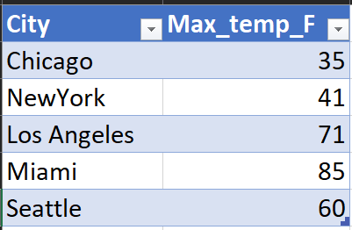
Step into the SAS Data step
Data step executes line by line of the code and observation by observation.
Consider the table in the right.
Supposed we wrote a data step to calculate Max_temp_C from Max_temp_F.
The datastep would first pick up the first obs Chicago and run through the entire datastep and write the result to the output buffer, then go to the seconds observation (NewYork) and execute all the statements for that observation, write it to the buffer and so on.. Until it finishes processing of all the observations in the input data.
This is also referred to as the implicit looping in datastep.

Slide 11
Data processing – compile and execution
Compile phase
Creates PDV
Checks for errors in variable names, syntax errors etc
Execution phase
When reading from external input file, data is read into an input buffer.
Next data is loaded into the PDV (program data vector)
Reads/ processes one record at a time
When reading from a file using infile/ input statement, the values in the pdv are set to missing at the beginning of each iteration.
When reading from a dataset, the values are set to missing the first time and the values are overwritten by the next observation during each read iteration.
Data written to output buffer/ dataset at the end of datastep or when output statement is encountered.

Slide 12
SAS log
In SAS Studio (and other SAS environments), you will see a program editor (or a code window).
When you submit the program, you will see the log, output, results and output data windows.
The log window is your first stop.
Check for WARNING: and ERROR: messages. If there are any, address them and rerun the code.
Understand what input was processed and what was written out from the log using the NOTE:.
Don’t check output without viewing the log.
You can write additional info to the log during development to make sure that your logic is working correctly.

Slide 13
Getting data into SAS
Options to get data into SAS.
Enter the data manually using datalines/ cards option in the datastep.
Good for testing or creating a quick sample.
Prone to errors and not scalable.
Read data from raw input files using data step or proc import.
CSV input files are the most popular of these.
Read data from other data sources such as databases using SAS/ ACCESS.
In SAS Viya, there are also CAS Data Connectors that let you read data directly into the CAS Engine. (Just FYI, don’t worry about this for now)

Slide 14
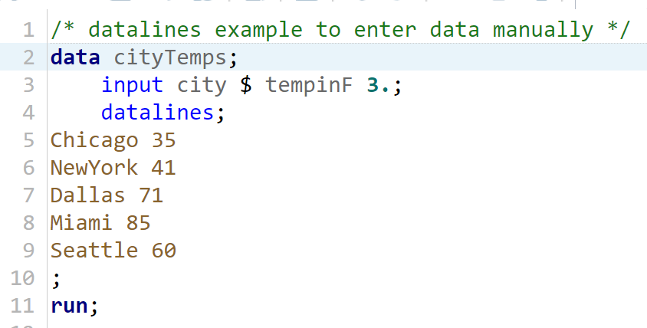
Get data into SAS - datalines
Consider the program.
Line 1 is a comment /* block comment */ or *single line;
Line 2
data is the keyword indicating the start of a datastep
cityTemps is the name of the output dataset to be created from this step.
Line 3:
input is the keyword that tells SAS that we are reading external data (from datalines or an external source).
city is the name of the first variable being read and $ indicates that it is a character type.
tempinF is the name of the second variable being read and 3. indicates that it is of type numeric and length 3.
Line 4 and line 10: datalines and ; indicates that data is being passed in this section. Note that the datalines; must be last statement in the datastep.
Line 11: run; indicates the end of the datastep.

Slide 15
Get data into SAS – external Files
Data step using infile and input statements.
Infile statement tells SAS where to find the file.
Input Statement tells SAS how the data is structured in the input file and what is the associated data type

Slide 16
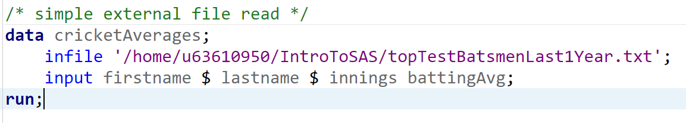
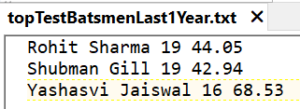
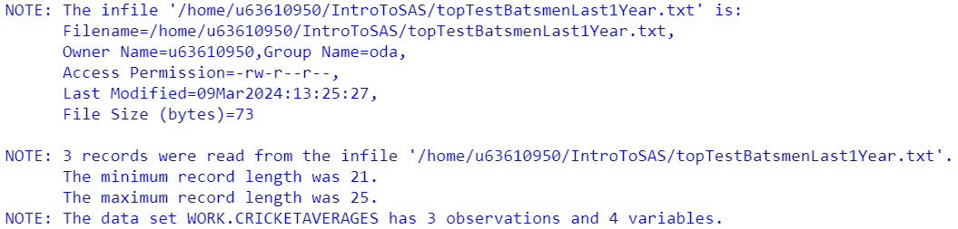
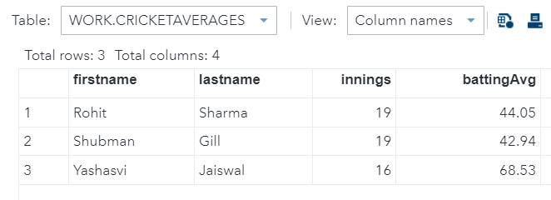
Simplest external file read – the list input
The default record length (number of characters including spaces in a data line) is 256.
If your data lines are longer, then it could cause truncation of data. To prevent this use lrecl= option on the infile statement according to the length of the data line that you are reading.
Example:
infile '/home/u63610950/IntroToSAS/topTestBatsmenLast1Year.txt' lrecl=500;
Notes:
Instead of datalines statement in the previous example, we are using infile statement to read from an external file.
Input statement is similar and simple.
Log provides useful info such as min and max record length. It indicates any problems that occur during import.
List input:
Data columns are separated by space in input file.
Must read all te data in a line, no skipping of unwanted data.
Missing values must be indicated with a period.
No embedded spaces.
If there are dates, then this might not be the best approach.

Slide 17
Read external Input into SAS
Demo

Slide 18
Reading informats
SAS can read any kind of data because it has tons of informats.
Informats: Informats by Category - 9.2 (sas.com)

Slide 19
Infile statement options
Firstobs= tells SAS which obs to start reading
Obs= tells SAS how many lines of data to read.
Combine firstobs=x and obs=y to read the data from line x to y (obviously y>x)
Missover – don’t go to the next line to read more data if you run out of data in the current line.
Truncover – its like missover but for column formatted inputs.

Slide 20
Reading delimited files
CSV files are most widely used formats for transferring data.
Sometimes other delimiters such as tab or pipe (|) are also used.
Use infile statement options to read delimited files.
Dlm=‘,’ – tells SAS that the file uses comma as a delimiter instead of space (default delimiter value)
Dlm=‘09’x is tab delimiter.
DSD - By default, SAS interprets 2 consecutive delimiters (with no other characters between them) as a single delimiter. If your file has missing values add DSD option to the infile statement.
It ignores delimiter values enclosed in quotation marks.
It doesn’t read quotation marks as part of the data value.
It treats 2 delimiters in a row as a missing value

Slide 21
Proc import
Easy to read certain kinds of files.
Scans your data file and automatically determines variable length, types, and formats.
Treats 2 consecutive delimiters as a missing value.
Reads values in quotation marks
Assign missing value when it runs out of data on a line (similar to missover functionality).
It creates the data step infile, input statements behind the scenes. Check the log.

Slide 22

Proc import.. options
Consider this code..
Proc import is the procedure to import external files.
Datafile – identifies the external data file.. A fileref is used here.
Out – specifies the name of the sas dataset to be created upon reading the external file.
Dbms – specify the file type. (dbms=csv is a CSV file, dbms = TAB is a tab delimited file).
For other delimiters use, DBMS=DSD along with the delimiter= option in the proc import statement; example dbms=DSD delimiter=‘|’
Replace option tells SAS to overwrite the output dataset if it exists.
Getnames statement tells sas whether or not the variable names are available in the input file.

Slide 23

Proc import.. For PC Files
Consider the following code:
Dbms=xlsx tells sas that we are reading an excel file. Older version have dbms identifier as EXCEL.
Sheet= statement tells SAS which sheet to read.
Proc import for XLSX requires licensing the SAS ACCESS for PC FILES interface.

Slide 24
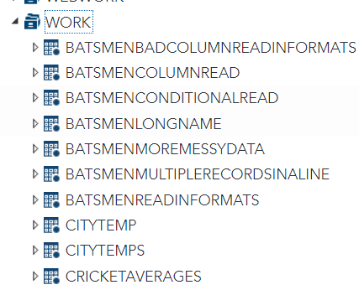
The SAS Work library
SAS Datasets are stored in either temporary or permanent
All the datasets we created in our examples so far using the datastep were stored in the work library.
Did we mention work library anywhere?
SAS by default stores the data in the work library.
SAS creates a work library during startup. This location is configured in the sasv9.cfg and can be modified at invocation of SAS using the –WORK invocation option.
Work location cannot be changed after SAS startup.
Fun fact: If disk space is full in the work directory, then SAS might not start up.
Any data stored in the work library is deleted at the end of the session (unless SAS isn’t shut down properly).

Slide 25
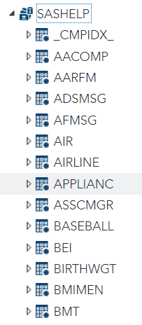
Permanent datasets – libname statement
To save data permanently, you must define a permanent location and tell SAS about it using the libname statement.
The reference to the permanent location you create using the libname statement is called a libref.
Example
libname mypath ‘c:\mypath’;
mypath is the libref which refers to the location ‘c:\mypath’
To store a dataset to this location, qualify the dataset using the libref (referred to as a two-level dataset name).
data mypath.myDS;
Permanent datasets remain even after you close your session.
There are some useful permanent libraries provided by SAS. One we will see a lot is SASHELP.

Slide 26
A few Basic procedures

Slide 27
Basic procedures
Proc sort – sort your data
Proc print – print the data.. has lots of options and statements.
Proc means – summarize your data and get some basic stats.
Proc freq – create frequency tables
Proc sgplot – plot your data
Others which we will see later
Proc format
Proc report
Proc SQL

Slide 28
Basic Procs
Demo

Slide 29
Next Class
Data step manipulation
Set statement
Using SAS functions
Put, length and retain statements
Applying Formats
Keep, drop, where
Conditional processing.. If then else
If vs Where
Arrays
Merge statement
Proc sql
Inner join , left join, full join
One to one, one to many, many to one
Compare sql vs datastep

